Slide 1
Department of Applied Mathematics and Computational Sciences
III Sem M.Sc.Software Systems
Transform Techniques
Dr. V. Suresh kumar

Slide 2
Inverse Laplace Transform

Slide 3
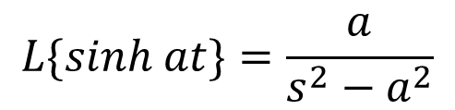

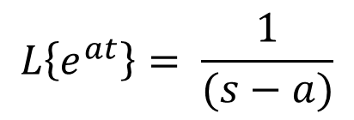
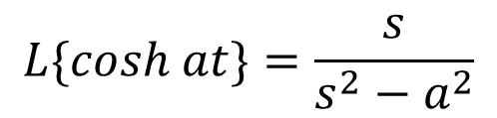

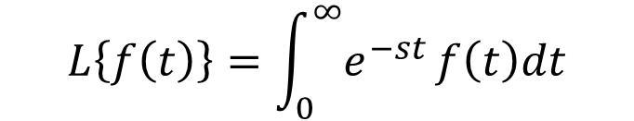

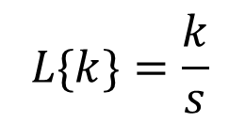
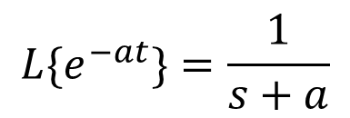
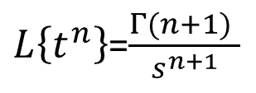
List of Transforms
$$F(S)$$
$$L\left\{f\left(t\right)\right\}=\int_{0}^{∞}{e^{−st}}f\left(t\right)dt$$
$$L\left\{e^{at}\right\}= \frac{1}{(s−a)}$$
$$L\{cosh at\}=\frac{s}{s^{2}−a^{2}}$$
$$L^{−1}\left[F\left(S\right)\right]= ?$$
$$f(t)$$
$$L\{sinh at\}=\frac{a}{s^{2}−a^{2}}$$
$${L\{e}^{−at}\}=\frac{1}{s+a}$$
$L\left\{t^{n}\right\}$=$\frac{Γ(n+1) }{s^{n+1}}$
$$L\{k\}=\frac{k}{s}$$

Slide 4
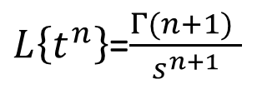
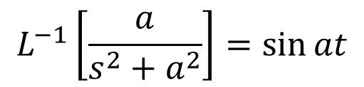


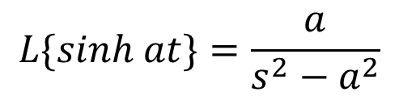
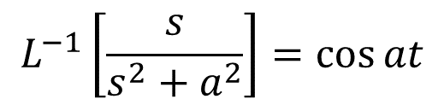



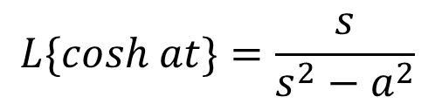
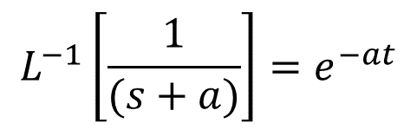
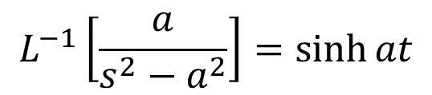
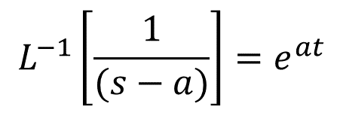


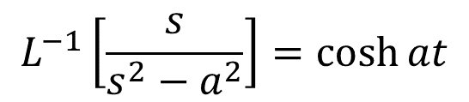
List of Inverse Transforms
$$L\{f\left(t\right)\}=F(s)$$
$$L^{−1}\left[F\left(S\right)\right]=f(t)$$
$$L\left\{e^{at}\right\}= \frac{1}{(s−a)}$$
$$L^{−1}\left[\frac{1}{(s−a)}\right]=e^{at}$$
$$L\{cosh at\}=\frac{s}{s^{2}−a^{2}}$$
$$L^{−1}\left[\frac{s}{s^{2}−a^{2}}\right]=\cosh{at}$$
$$L\{sinh at\}=\frac{a}{s^{2}−a^{2}}$$
$${L\{e}^{−at}\}=\frac{1}{s+a}$$
$$L^{−1}\left[\frac{a}{s^{2}−a^{2}}\right]=\sinh{at}$$
$$L^{−1}\left[\frac{1}{(s+a)}\right]=e^{−at}$$
$$L^{−1}\left[\frac{1}{s^{n}}\right]=\frac{t^{n−1}}{Γ(n)}$$
$$L^{−1}\left[\frac{s}{s^{2}+a^{2}}\right]=\cos{at}$$
$L\left\{t^{n}\right\}$=$\frac{Γ(n+1) }{s^{n+1}}$
$$L^{−1}\left[\frac{k}{s}\right]=k$$
$$L\{k\}=\frac{k}{s}$$
$$L^{−1}\left[\frac{a}{s^{2}+a^{2}}\right]=\sin{at}$$

Slide 5
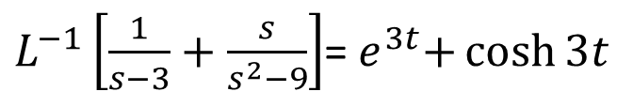



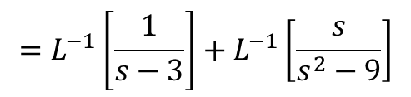
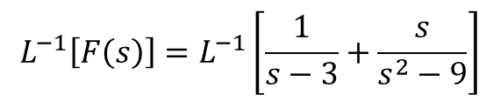
Example problems
1. Find the Inverse Laplace Transform of $\frac{1}{s−3}+\frac{s}{s^{2}−9}$
Ans:
Take $F(s)= \frac{1}{s−3}+\frac{s}{s^{2}−9}$
$$L^{−1}\left[F\left(s\right)\right]=L^{−1}\left[\frac{1}{s−3}+\frac{s}{s^{2}−9}\right]$$
$L^{−1}\left[\frac{1}{s−3}+\frac{s}{s^{2}−9}\right]$=${ e}^{3t}+\cosh{3t}$
$$=L^{−1}\left[\frac{1}{s−3}\right]+L^{−1}\left[\frac{s}{s^{2}−9}\right]$$
$$=e^{3t}+\cosh{3t}$$
$$=f(t)$$

Slide 6


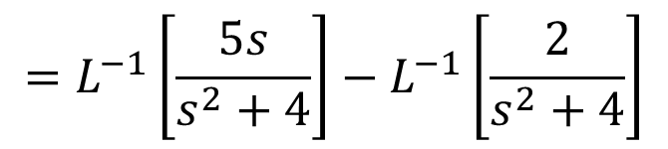
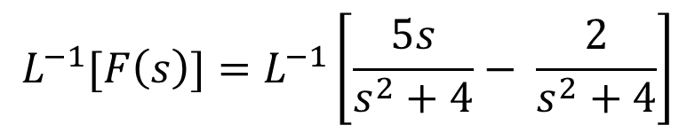
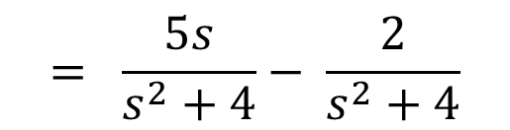
Problems cont…
2. Find the Inverse Laplace Transform of
Ans:
Take $F(s)= \frac{5s−2}{s^{2}+4}$
$$= \frac{5s}{s^{2}+4}− \frac{2}{s^{2}+4}$$
$L^{−1}\left[F\left(s\right)\right]=5cos2t−\sin{2t}$
$$L^{−1}[F\left(s\right)]=L^{−1}\left[\frac{5s}{s^{2}+4}− \frac{2}{s^{2}+4}\right]$$
$$=L^{−1}\left[\frac{5s}{s^{2}+4}\right]−L^{−1}\left[\frac{2}{s^{2}+4}\right]$$

Slide 7
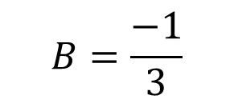
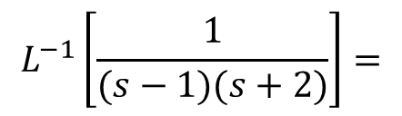
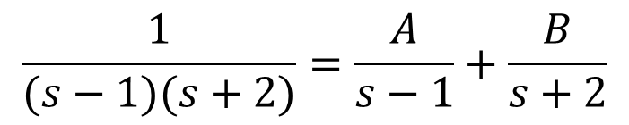
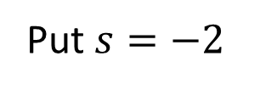
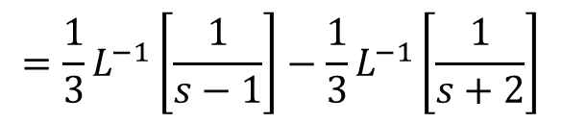
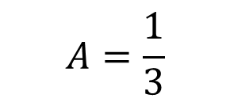
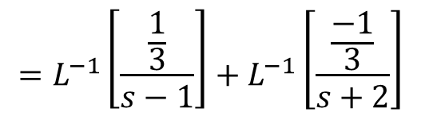
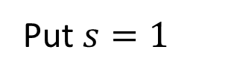
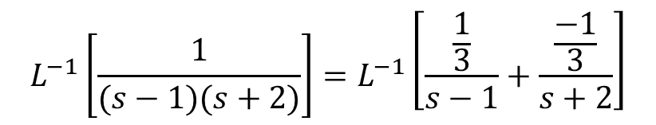

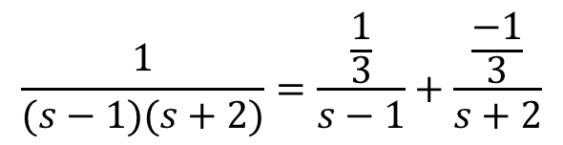
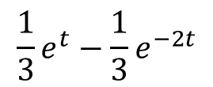
Problems cont…
3. Find the Inverse Laplace Transform of $\frac{1}{(s−1)(s+2)}$
Ans:
$$\frac{1}{(s−1)(s+2)}=\frac{\frac{1}{3}}{s−1}+\frac{\frac{−1}{3}}{s+2}$$
$$\frac{1}{(s−1)(s+2)}=\frac{A}{s−1}+\frac{B}{s+2}$$
$$L^{−1}\left[\frac{1}{(s−1)(s+2)}\right]=L^{−1}\left[\frac{\frac{1}{3}}{s−1}+\frac{\frac{−1}{3}}{s+2}\right]$$
$$1=A\left(s+2\right)+B(s−1)$$
$$=L^{−1}\left[\frac{\frac{1}{3}}{s−1}\right]+L^{−1}\left[\frac{\frac{−1}{3}}{s+2}\right]$$
Put $s=1$
Put $s=−2$
$$={\frac{1}{3}L}^{−1}\left[\frac{1}{s−1}\right]−\frac{1}{3}L^{−1}\left[\frac{1}{s+2}\right]$$
We get
We get
$$A=\frac{1}{3}$$
$$B=\frac{−1}{3}$$
$$L^{−1}\left[\frac{1}{(s−1)(s+2)}\right]=$$
$$\frac{1}{3}e^{t}−\frac{1}{3}e^{−2t}$$

Slide 8
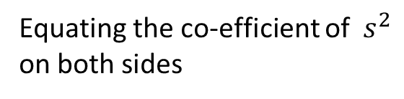

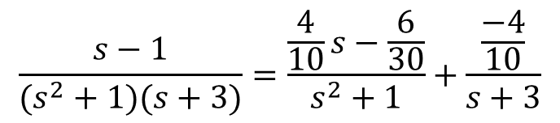
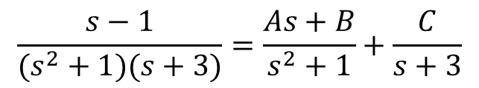
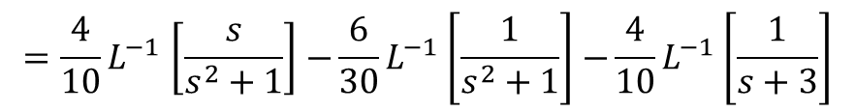
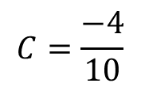

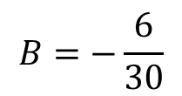
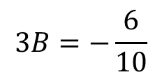
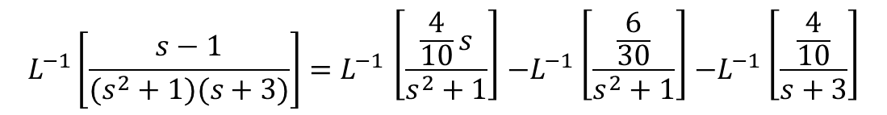

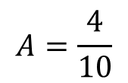

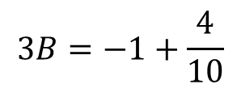
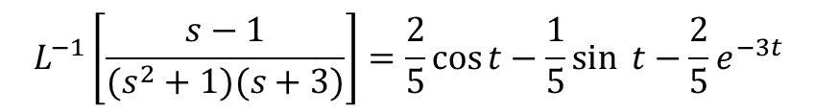

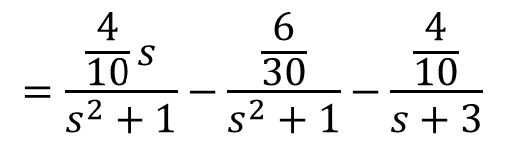




Problems cont…
4. Find the Inverse Laplace Transform of $\frac{s−1}{(s^{2}+1)(s+3)}$
$$\frac{s−1}{(s^{2}+1)(s+3)}=\frac{\frac{4}{10}s−\frac{6}{30}}{s^{2}+1}+\frac{\frac{−4}{10}}{s+3}$$
Ans:
$$\frac{s−1}{(s^{2}+1)(s+3)}=\frac{As+B}{s^{2}+1}+\frac{C}{s+3}$$
$$=\frac{\frac{4}{10}s}{s^{2}+1}−\frac{\frac{6}{30}}{s^{2}+1}−\frac{\frac{4}{10}}{s+3}$$
$s−1$= $(As+B)(s+3)$+ $\left(s^{2}+1\right)C$
Put $s=−3$
$$L^{−1}\left[\frac{s−1}{(s^{2}+1)(s+3)}\right]{=L}^{−1}\left[\frac{\frac{4}{10}s}{s^{2}+1}\right]{−L}^{−1}\left[\frac{\frac{6}{30}}{s^{2}+1}\right]{−L}^{−1}\left[\frac{\frac{4}{10}}{s+3}\right]$$
Put $s=0$
$$−3−1=0+\left(9+1\right)C$$
$$C=\frac{−4}{10}$$
$$−1=(B)(3)+\left(1\right)C$$
$${=\frac{4}{10}L}^{−1}\left[\frac{s}{s^{2}+1}\right]{−\frac{6}{30}L}^{−1}\left[\frac{1}{s^{2}+1}\right]{−\frac{4}{10}L}^{−1}\left[\frac{1}{s+3}\right]$$
$$3B=−1−C$$
Equating the co-efficient of $s^{2}$
on both sides
$$3B=−1+\frac{4}{10}$$
$$=\frac{4}{10}\cos{t}−\frac{6}{30}\sin{ t}−\frac{4}{10}e^{−3t}$$
$$0=A+C$$
$$3B=−\frac{6}{10}$$
$$A=−C$$
$$L^{−1}\left[\frac{s−1}{(s^{2}+1)(s+3)}\right]=\frac{2}{5}\cos{t}−\frac{1}{5}\sin{ t}−\frac{2}{5}e^{−3t}$$
$$A=\frac{4}{10}$$
$$B=−\frac{6}{30}$$

Slide 9
Problems for homework
Find the Inverse Laplace Transform for the following
1.
4.
7.
2.
5.
8.
6.
3.

Slide 10


